Slide 1

Omair Duadu
Lab 4
14/12/2021

Slide 2
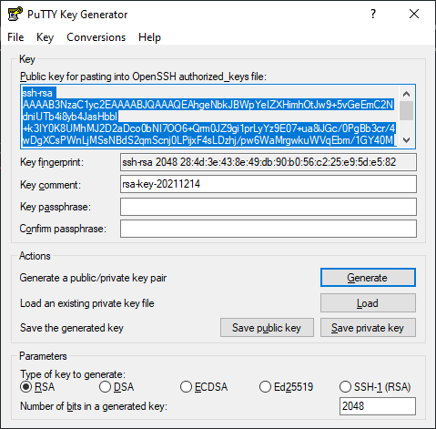
Part A – Private and Public Key generation
I used PuTTygen to create my public and private key as I already had it and it is works well.
I made sure to save the files for later use in the Lab 4 folder for the madvanced security module.

Slide 3



Part B- Enigmail
Postbox is used for the sending of the encrypted email and the public key is attached for decryption purposes.
This is a very cool piece of technology as one is able to send encrypted emails, and only the receiver with the public key has the abilities to read the encrypted messages.
Postbox, Mozilla Thunderbird, and Interlink Mail have an Enigmail extension which can allow them to encrypt and decrypt emails & attachments that are sent & received

Slide 4
Part C – Clock Attacks
Some examples of attacks that can be carried out against systems that rely on time via NTP are
Certificate Attacks
Authentication Attacks
DNSSEC Attacks
NTP Amplification
Systems with clocks are integral for deadlines and automated systems such as my coffee machine and fridge, as well as financial services, and big companies.
There are three main attack types such as moving clock back, stopping the clock and moving it forwards, as well as moving it forward.

Slide 5
Part D – RSA Algorithim
RSA is an asymmetric encryption algorithm, which means it uses a pair of keys one public one private. Only someone with possession the private key can decrypt something encrypted with the public key. It’s based on the fact that it’s hard to factor large prime numbers, keys are generated as the result of two numbers being multiplied together, combined with entropy. Meaning if someone can factorize the number they will be able to break the keys.

